Slide 1

ANALYSIS OF MYNTRA APPAREL

Slide 2
Click on the icon to see the excel file

Slide 3
DATA CLEANING AND PREPARATION

Slide 4
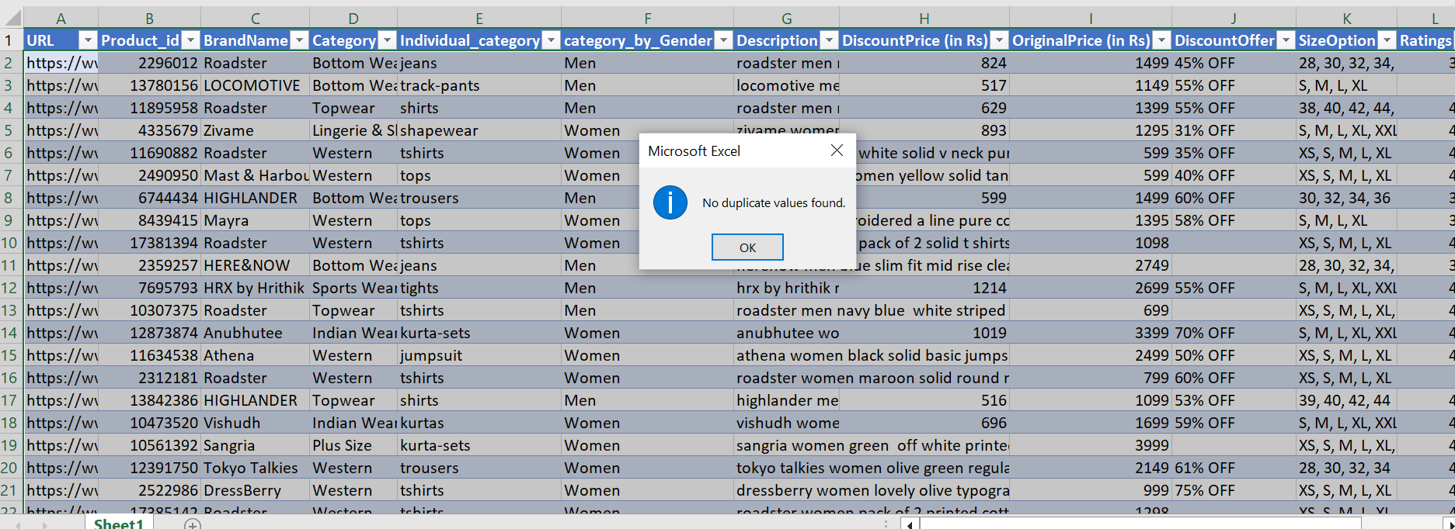
1. Check for duplicate values in your dataset and remove them.
Select the productid coloumn
Go to Remove Duplicates.
No duplicate value found.

Slide 5
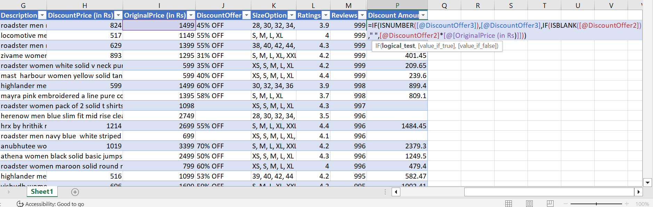
2. Standardize the "DiscountOffer" column to a single format, ensuring all values are uniform.
=IF(ISNUMBER([@DiscountOffer3]),[@DiscountOffer3],IF(ISBLANK([@DiscountOffer2])," ",[@DiscountOffer2]*[@[OriginalPrice (in Rs)]]))

Slide 6
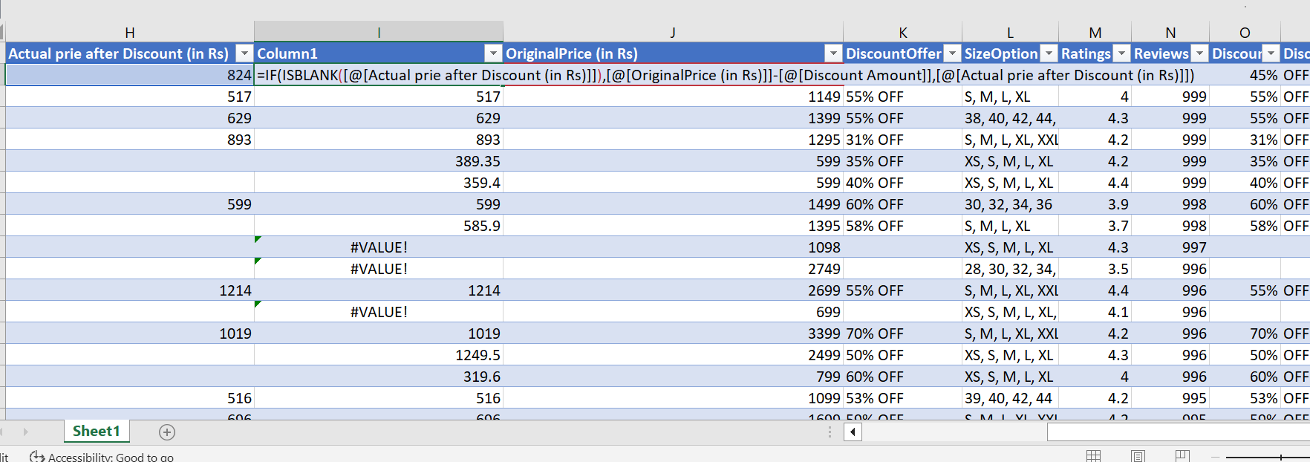
To find actual price after discount for blank cells
=IF(ISBLANK([@[Actual prie after Discount (in Rs)]]),[@[OriginalPrice (in Rs)]]-[@[Discount Amount]],[@[Actual prie after Discount (in Rs)]])

Slide 7
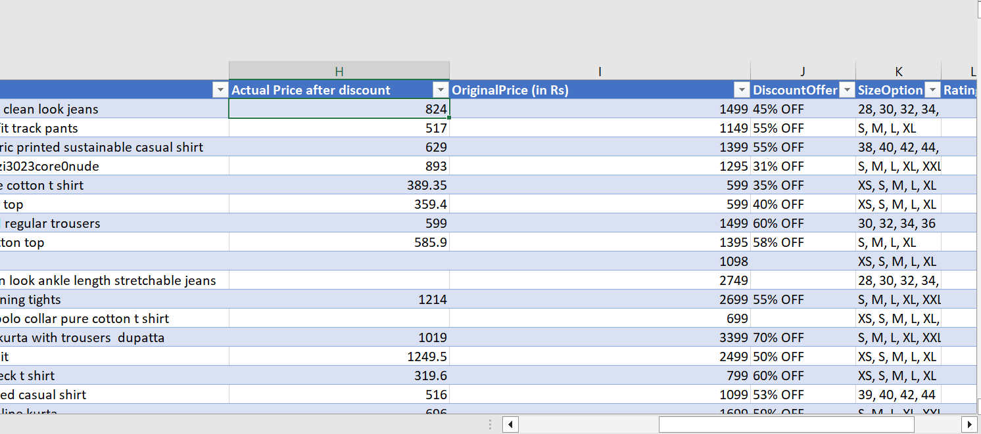
To remove #value from Actual price after discount
=IF(ISERROR([@Column1])," ",[@Column1])

Slide 8
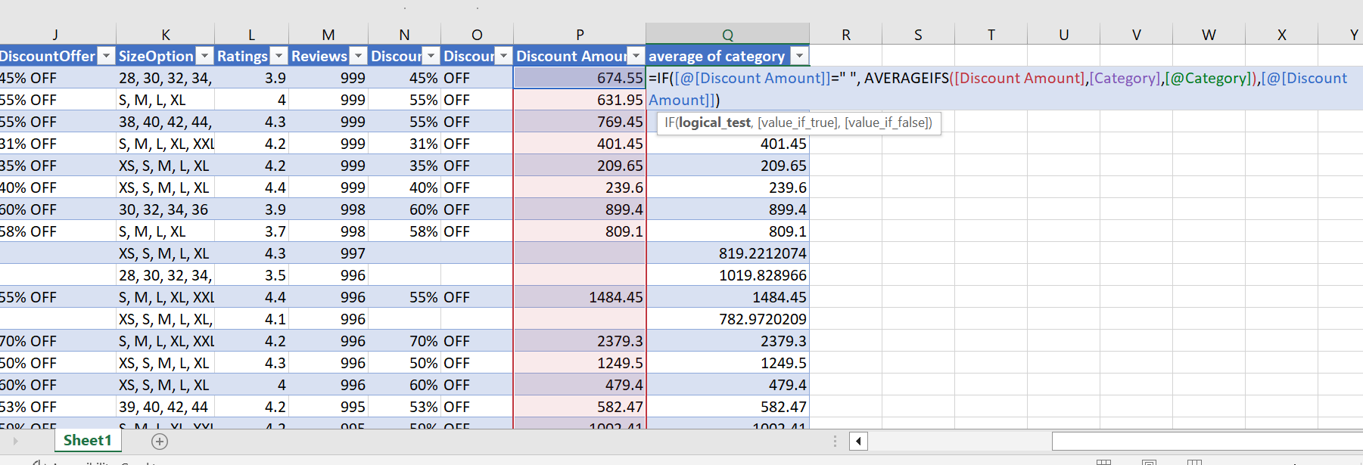
3. Identify rows where both "DiscountPrice" and "DiscountOffer" are null and fill the "DiscountPrice" with the average discount price of the respective category.
=IF([@[Discount Amount]]=" ", AVERAGEIFS([Discount Amount],[Category],[@Category]),[@[Discount Amount]])

Slide 9
4. Replace all null values in the "SizeOption" column with the text "Not Available."
No null values in size option

Slide 10
DATA ANALYSIS

Slide 11
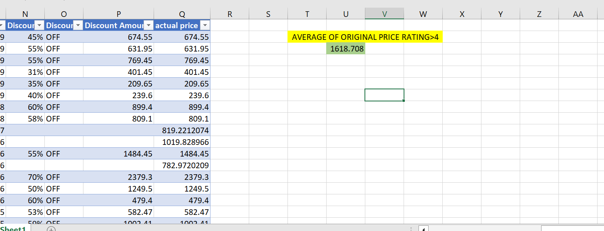
1. Calculate the overall average original price for products with ratings greater than 4.
=AVERAGEIF(Table1[Ratings],">4",Table1[OriginalPrice (in Rs)])

Slide 12
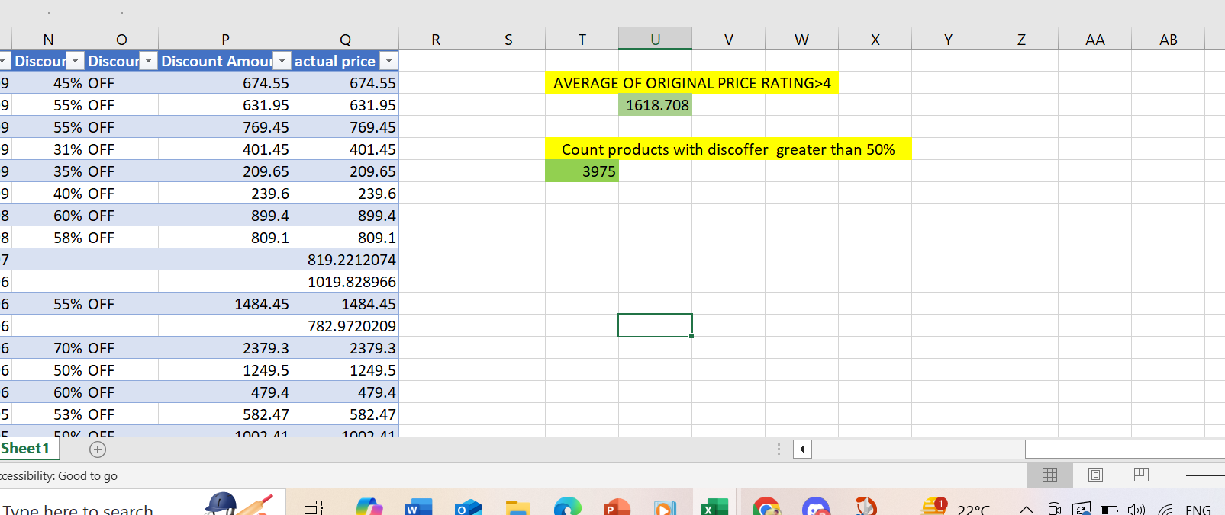
2. Count the number of products with a discount offer greater than 50% OFF.
=COUNTIF(Table1[DiscountOffer2],">=50%")

Slide 13
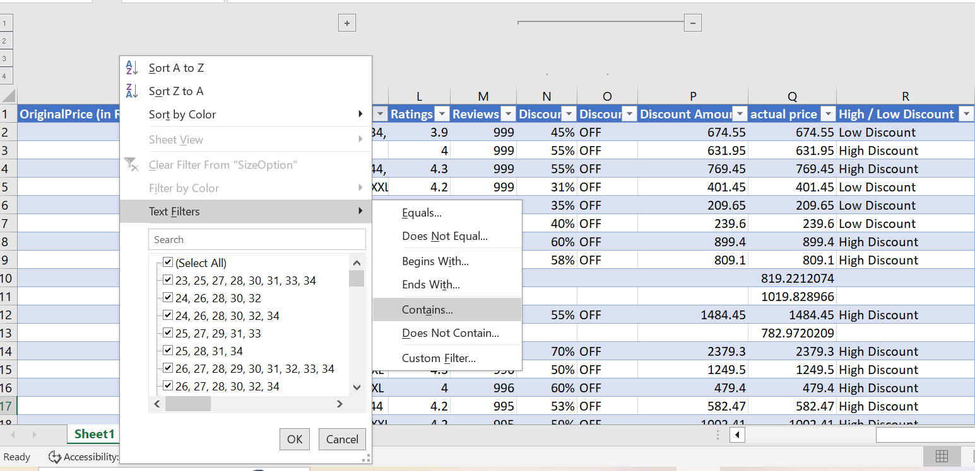
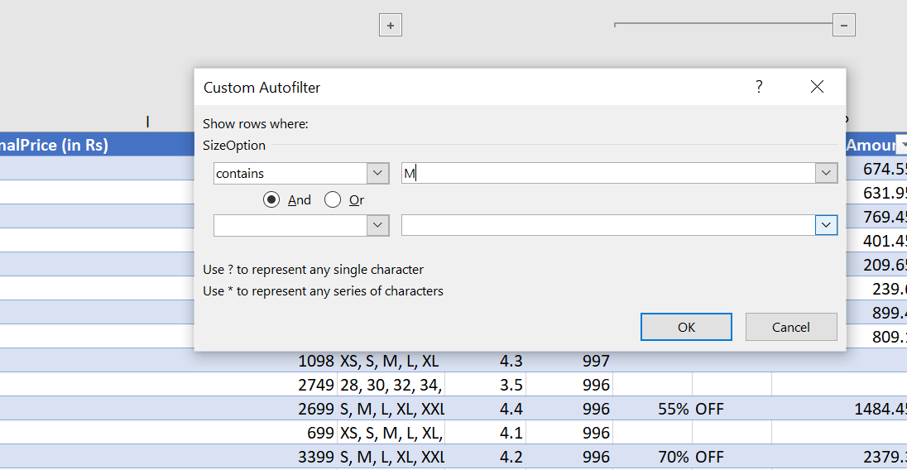
3. Count the number of products available in size "M."

Slide 14
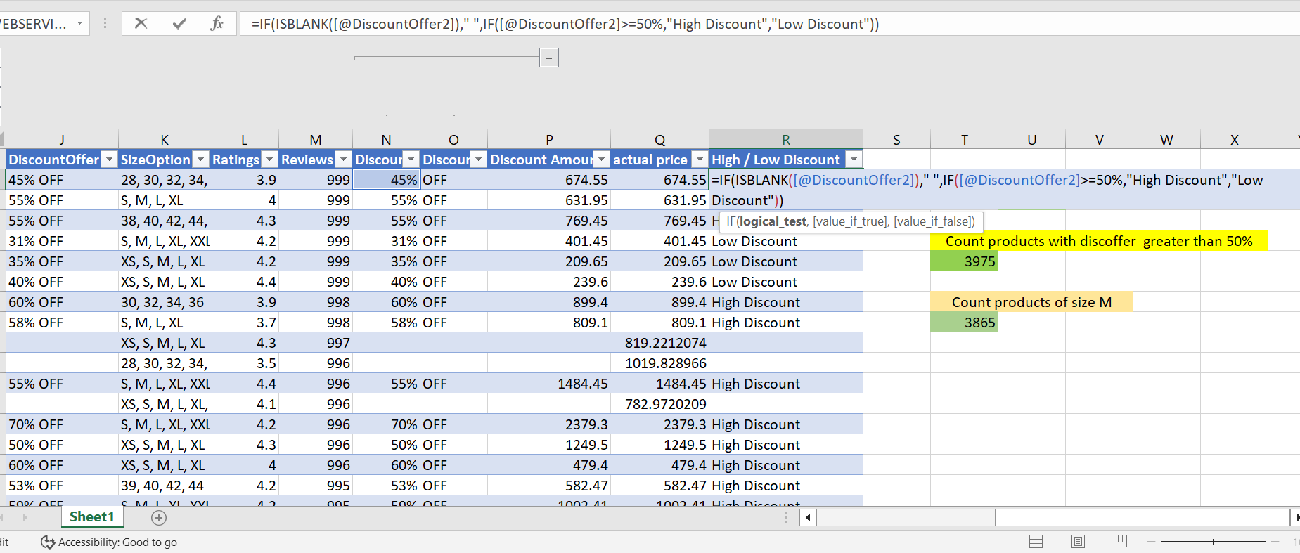
4. Create a new column to label the products as "High Discount" if the discount offer is greater than 50% OFF, otherwise label them as "Low Discount."
=IF(ISBLANK([@DiscountOffer2])," ",IF([@DiscountOffer2]>=50%,"High Discount","Low Discount"))

Slide 15
Data Retrieval and Lookup

Slide 16
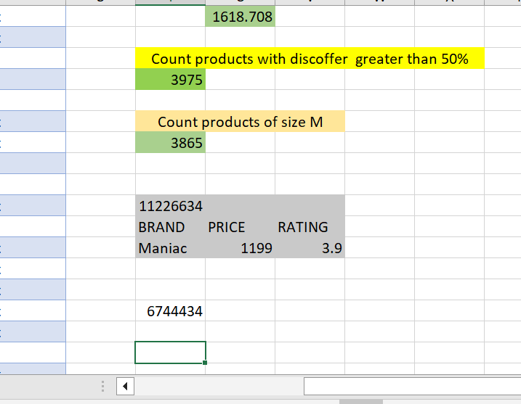
1. Use VLOOKUP/XLOOKUP to find the product brand, price, and rating of the product with Product_id "11226634".
BRAND
=VLOOKUP(T12,Table1[[Product_id]:[BrandName]],2,FALSE)
PRICE
=VLOOKUP(T12,Table1[[Product_id]:[OriginalPrice (in Rs)]],8,FALSE)
RATING
=VLOOKUP(T12,Table1[[Product_id]:[Ratings]],11,FALSE)

Slide 17
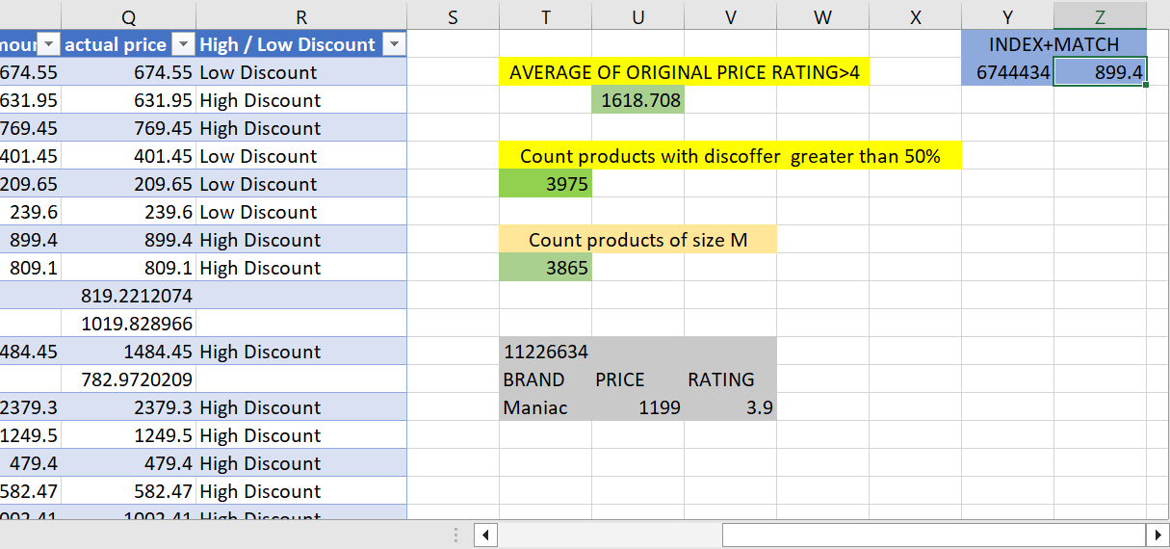
2. Find the "DiscountPrice" for the product with the Product ID "6744434" using the INDEX and MATCH functions.
=INDEX(P:P,MATCH(Y2,B:B,0))

